Slide 1
Process and Thread Synchronisation Concepts
Lecture 2 of 4
Mutual Exclusion
Semaphores, Mutexes, Monitors
Producer/Consumer Problems
Events, Conditions and Rendezvous.
Note: Make sure you have reviewed Lecture 8 before reading this lecture
Note: Examples of the concepts presented here can be found in the RTExamples folder: Q8
You are encouraged to open the project(s) in Visual Studio and run the program(s)
©Paul Davies 2020. Not to be copied, used, or revised without explicit written permission from the copyright owner. This lecture may contain animations and is best viewed as a slide show

Slide 2
A Generic Solution to Solving Mutual Exclusion
In the last lecture, we looked at a couple of ‘flag’ based approaches to solving mutual exclusion between two threads running in
  A time-slicing environment, by disabling interrupts
  On multiple cores using a Test and Set (TAS) type operation
Even though both worked, neither solution was perfect. In fact, both solutions suffered from the same limitations, namely that they :-
  Wasted CPU time due to the actions of a ‘Busy waiting loop’ (or spin lock) that repeatedly tested and set a flag to determine if a resource was free.
  There was no queuing mechanism built in, which could give rise to the possibly of indefinite lockout, (where we could not guarantee that a thread would ever gain access to a resource).
  Gave rise to non-deterministic behaviour from programs. We couldn’t predict how long a task would take to acquire a resource and hence how long the task would take to complete.

Slide 3
To solve mutual exclusion in a generic way, we need a solution that removes all these drawbacks, i.e.
  Avoids spin-lock approach or disabling of interrupts.
  Implements queuing to prevent indefinite lockout leading to more deterministic behaviour.
  Works for both time-sliced and a multi-core systems
  Is easy to use, i.e. the user not having to worry about the implementation details or have to resort to assembly language.
If we are to achieve this, then we must move any flag based variable (which is at the heart of both previous solutions), out of the direct control of each task and place it under the control of the Operating System kernel itself, which is able to control time slicing and multi-core scheduling.
This would allow the OS to suspend a task that is blocked and place it into a first-in, first-out queue, thus avoiding indefinite lockout and leading to a more deterministic system.

Slide 4
The General Solution to Mutual Exclusion
The Dutch mathematician and computer scientist Dijkstra is generally credited with solving the problem of mutual exclusion (and many other related topics). http://en.wikipedia.org/wiki/Edsger_W._Dijkstra
It is believed that he came up with the solution after studying a real life mutual exclusion problem in the form of trains sharing a single track railway line (a classic non-sharable resource if ever there was one).
He observed that single track railway lines were partitioned, or split into multiple critical sections, so that many trains could actually share the same railway track, but only one train was allowed to enter each critical section of the track at any one time. The others would have to wait outside.
This is analogous to two threads sharing a common resource. It’s OK for them to work independently and concurrently right up to the point where they both attempt to use the same non-sharable resource, at which point the accesses must be performed sequentially.
Dijkstra observed that a mechanical Signal was used to indicate when a section of single track was free or busy.

Slide 5
A train, arriving at the signal would wait to see if the section of track ahead was currently in use by another train (indicated by a raised/blocking signal).
When a train enters a section of track, it raises the signal behind it, thus preventing further access to the section of track by a following train.
When the train leaves a section of track, it “signals” or lowers the signal at the start of that section, thereby permitting a train arriving afterwards to enter.
This scheme prevents use of a section of track by more than one train. Most importantly one train does not block the whole line, just a critical section of track.
The scheme also implements a FIFO and avoids indefinite lockout (trains get their turn)
Dijkstra's solution in computing was to implement this Signalling concept within the Operating System Kernel using a Binary Semaphore and in doing so implement queuing and prevent indefinite lockout.
Free
Occupied
Free
Occupied
Occupied
Free
Signal
Signal
Signal
Wait
Critical Section 1
Wait
Critical Section 2
Wait
Critical Section 3

Slide 6
The Binary Semaphore
Used to Lock and
Unlock a Resource

Slide 7
A single binary semaphore is used to protect a single non-sharable resource in the system. You create as many semaphores as you need to protect all your resources.
The semaphore is used to “Lock” a resource for sole use by one thread. That thread then “Unlocks”, it some time later, when it has finished.
A binary semaphore is a protected variable (from the programmers perspective) created and maintained by the Kernel, and can have one of two values (hence the name “binary” semaphore) reflecting the state of the resource it is protecting to
  Signalled = 1, meaning the resource is free
  Not Signalled = 0, meaning the resource is busy or in use
Two system calls: Wait() and Signal() are available to allow your program to indirectly manipulate the value of the binary semaphore.
Of fundamental importance is the fact that once started Wait() and Signal() are guaranteed to complete (very quickly) without interruption. (OS ensures this). That is, we consider Wait() and Signal() to be atomic, or indivisible operations, even though many CPU instructions are required to perform their actions.
see http://en.wikipedia.org/wiki/Semaphore_(programming) )

Slide 8
Using a Binary Semaphore ‘S’ to enforce Mutual Exclusion
Each thread must be written to perform a Wait() on a semaphore ‘S’ (to lock the resource) before accessing it, followed by a Signal() on ‘S’ (to unlock the resource) after it has finished. Each process is written thus.
S.Wait()
access non-sharable resource
S.Signal()
Important : FIFO QUEUING is built in to semaphore usage. That is, threads form a line in the order they perform their “Wait()” operation. If the resource is locked (in use by another thread), they are suspended by the OS and are eventually released (to use the resource) in that same order. This prevents indefinite lockout and the need for Spin locks within each process.
The RT Library: CSemaphore Class
Semaphores are encapsulated by the CSemaphore class in the RT library
For more interesting examples of the use of semaphores in general see the “little book of semaphores” by Downey on the Canvas site.

Slide 9
Implementing the Wait() Primitive
The implementation of Wait() under Windows is shown below*.
If a thread performs a Wait() on a semaphore S with the value 0, (resource is busy) then the thread is suspended by the OS and moved into a FIFO queue until the resource becomes free.
If however a thread performs a Wait() on a semaphore S with the value 1, (resource is free) the thread decrements the semaphore, returns and continues uninterrupted.
Pseudo code for Wait() primitive on Semaphore (S)
If( S == 0 )
Append thread to waiting queue for S
Suspend thread;
else
S = S – 1;
One atomic, indivisible operation, i.e. only one thread is allowed to test and modify S at any time
A thread that is not blocked is allowed to decrement the semaphore to mark the resource as busy and return from the Wait() call
A thread that is blocked will be suspended in the middle of the Wait() operation until the resource becomes free and it finds itself at the head of the FIFO queue. At that point it will be woken up and allowed to return from the Wait() call without changing the semaphore’s value.
* Various OS’s may perform this operation in a number of slightly different ways, but the effect will be the same .

Slide 10
Implementing the Signal() Primitive
The implementation of Signal() under Windows is shown below*.
If there are no threads waiting to use the resource, then the semaphore is incremented back to 1.
Otherwise the thread at the head of the queue is woken up and allowed to resume processing. In this case the value of the semaphore does not change (meaning the resource remains in use, but the owner is swapped).
Pseudo-code for the Signal() primitive on Semaphore (S)
If( the FIFO queue for S is empty )
S = S + 1;
else
Remove thread T at head of queue waiting on S
Resume T
If no threads are waiting, semaphore set back to 1, indicating resource is now free
atomic only one thread is allowed to modify S at any time
Otherwise wake up the waiting thread at the head of FIFO queue and let it resume processing, i.e. let it return from it’s previously blocked Wait() call. In this case the semaphore’s value does not change, but ownership of the resource passes from one thread to the other
* Various OS’s may perform this operation in a number of slightly different ways, but the effect will be the same .

Slide 11
Visualisation of Wait() and Signal() operation
S.Wait() To Gain Entry
A
D
C
C
B
B
D
A
Blocked and Suspended
Resource
Resource
Semaphore ‘S’ Protecting Resource
Access
A
D
C
B
S.Signal() to Leave
Note Resource Stays Busy (S=0) when a thread leaves and there was a thread waiting
S = 1: Resource is FREE
Resource Becomes Free when a thread leaves and there are no threads waiting
S = 0: Resource is BUSY

Slide 12
Making Wait() and Signal() atomic operations inside OS
How does OS ensure only one Wait() or one Signal() is being executed at any given time?
The OS treats S as a non-sharable resource, thus Wait() and Signal() incorporate a TAS style “spin lock” on a “flag” variable to protect S from being read/modified by more than one thread at a time.
This works for both time-sliced and multi-core systems.
In the code below, a thread may have to wait inside its TestAndSet spin lock, but only for as long as it takes for the other thread (that has locked the flag) to update S and release the lock. This is generally much faster than updating the resource itself.
Atomic Pseudo code for Wait()
while ( TestAndSet( Flag ) == true)
;
If( S == 0 )
Flag = false ;
Append thread to waiting queue for S
Suspend thread;
else
S = S – 1;
Flag = false ;
Atomic Pseudo-code for Signal()
while ( TestAndSet( Flag ) == true)
;
If( the FIFO queue for S is empty )
S = S + 1;
Flag = false ;
else
Flag = false ;
Remove thread T at head of waiting queue for S
Resume T

Slide 13
Full picture for each thread
WAIT()
while ( TestAndSet( Flag ) == true)
;
If( S == 0 )
Flag = false ;
Append thread to waiting queue for S
Suspend thread;
else
S = S – 1;
Flag = false ;
Call WAIT() inside Kernel to Acquire Resource
User Program updates Resource
UPDATE RESOURCE
SIGNAL()
while ( TestAndSet( Flag ) == true)
;
If( the FIFO queue for S is empty )
S = S + 1;
Flag = false ;
else
Flag = false ;
Remove thread T at head of waiting queue for S
Resume T
Call SIGNAL() inside Kernel to Release Resource

Slide 14
Solving Mutual exclusion in Multi-threaded systems using a Semaphore
int a = 0 ; // thread wide global variable that needs protecting
CSemaphore S1 ("MyMutex", 1 ) ; // create semaphore = 1
UINT _ _stdcall Thread1(void *args) // child thread function
{
for (int i = 0; i < 100000000; i ++) {
S1.Wait() ;
a = a + 1;
S1.Signal() ;
}
return 0 ;
}
void main() // primary thread within this process
{
CThread thread1(Thread1, ACTIVE, NULL) ; // create child thread
for (int i = 0; i < 100000000; i ++) {
S1.Wait() ;
a = a + 1;
S1.Signal() ;
}
thread1.WaitForThread() ; // wait for child thread to finish
}
Access to a shared variable ‘a’ protected by Wait() and Signal() on a semaphore ‘S1’
Access to a shared variable ‘a’ protected by Wait() and Signal() on a semaphore ‘S1’

Slide 15
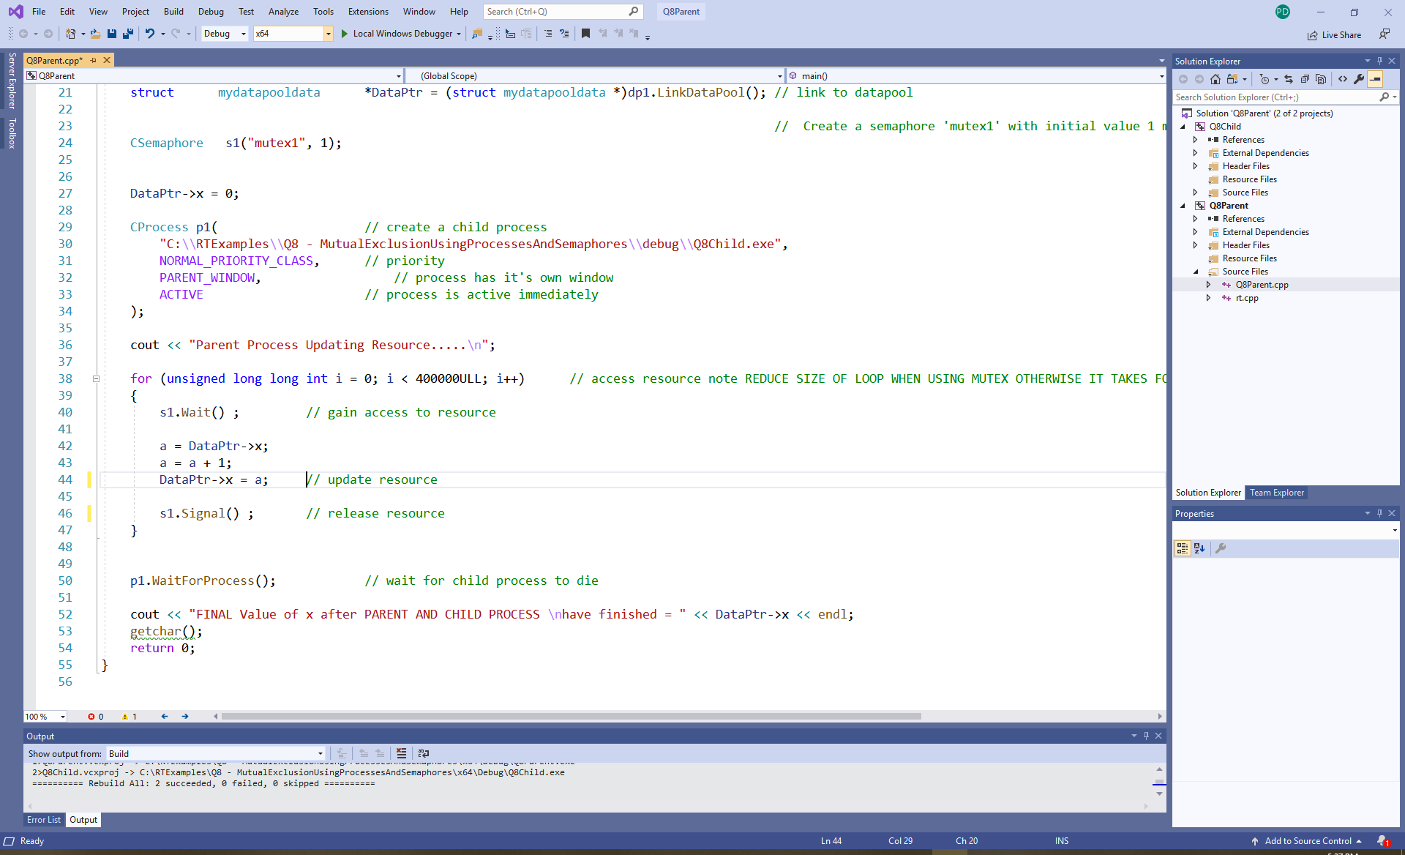
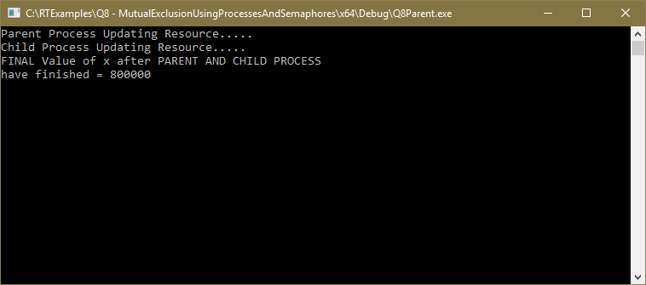
Q8 – Mutual Exclusion between two processes using semaphores: Correct answer = 800,000 however program is massively slower due to complexity of actions associated with Wait() and Signal()

Slide 16
Mutexes

Slide 17
Using a Mutex as an Alternative to a Semaphore: The CMutex Class
Essentially, a mutex is a thinly disguised binary semaphore which by default is always created with a value of 1 i.e. you do not have to specify its initial value.
Additional “Mutex” Properties
Under Windows, a mutex can only be signalled by the thread that has already acquired the resource. This is to prevent threads from accidently (or deliberately) attempting to unlock a resource through the use of a Signal() operation when it is not the owner of the resource.
A thread will not block itself if it performs a Wait() on a mutex that it has already acquired, but must remember to do the corresponding number of Signal() operations to release the resource afterwards. This is useful during recursive algorithms.
#include "rt.h"
  int main()
  {
  CMutex M("MyMutex") ; // create a local mutex with a default value of 1
  . . .
  for( int i = 0; i < 10000000; i ++) // access resource 10000000 times
  {
  M.Wait() ; // gain access to resource
  . . . // code to access a non-sharable resource
  M.Signal() ; // release resource
  }
  }
No need to specify the initial value of a mutex as it is assumed to be '1'

Slide 18
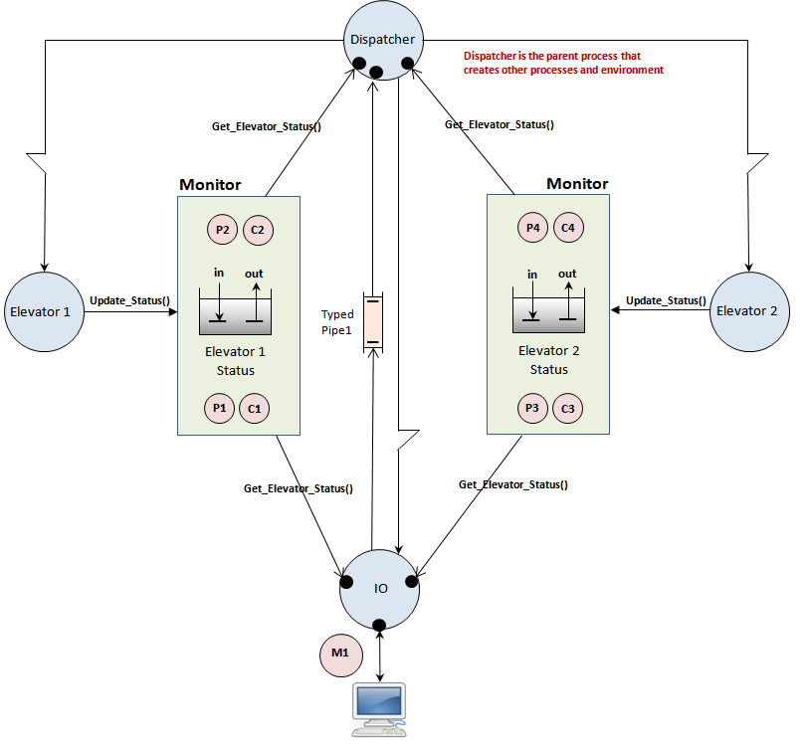
An arrangement of 4 binary semaphores inside a monitor to solve a producer/consumer problem (see next lecture).
A Mutex used in your assignment to enforce mutual exclusion between two threads writing to the screen

Slide 19
Monitors

Slide 20
The problem with using a Mutex or Semaphore to enforce mutual exclusion is that their success relies on the programmer writing “safe code”.
Any bugs or bad programming such as
  Failing to even identify that a particular resource needs protecting in the first place (and thus failing to use a Semaphore or Mutex to protect it)
  Failure to perform the correct Signal() and Wait() operations on a Semaphore or Mutex at the right time or in the right order.
could mean that the whole system could become locked, with every thread blocked and nobody able to access the resource.
‘Tony Hoare’ (famous for the quick sort algorithm amongst many things) proposed a solution to these problems in the form of a Monitor in one of his many seminal papers in this area back in 1975.
(See: http://en.wikipedia.org/wiki/Monitor_(synchronization) )

Slide 21
What is a Monitor?
A Monitor is essentially a C++ class that encapsulates the resource that you are trying to protect, while at same time providing simple interface functions to allow your programs to manipulate that resource correctly.
Rather than have users identify and remember to use Semaphores or Mutexes inside each of their own threads, they are instead built into or encapsulated within the Monitor itself. In effect hiding it away from the programmer and placing it in one central point of access for all threads.
It is thus down to the designer of the non-sharable resource to take responsibility for enforcing the synchronisation of threads using it rather than rely on the user of the resource to write the synchronisation in their own code.
It is thus the monitor’s interface functions (rather than the users application code) that call the Wait() and Signal() operations on any Semaphores or Mutexes hidden inside the monitor.
Such a scheme creates an inherently ‘Thread Safe resource’. The user does not need to consider if the resource is sharable or non-sharable, the resource itself knows that and enforces synchronisation accordingly.
  https://en.wikipedia.org/wiki/Thread_safety

Slide 22
An example “Un-Named” Monitor demonstrating Mutual Exclusion : Withdraw() and Deposit()
class BankAccount {
private:
double Balance ; // the data to be protected, a simple ‘double’
CMutex *theMutex;
public:
void Withdraw (double amount) {
theMutex -> Wait() ;
Balance = Balance - amount ;
theMutex -> Signal() ;
}
void Deposit (double amount) {
theMutex -> Wait() ;
Balance = Balance + amount ;
theMutex -> Signal() ;
}
// constructor creates a hidden mutex and destructor destroys it
BankAccount () { theMutex = new CMutex (“MyBankAccountName”) ; Balance = 0.0 ; }
~BankAccount () { delete theMutex; }
} ;
Because of the mutex calls inside each function, only one thread can ever be active inside the class at any point in time.
If two threads try to “withdraw” or two try to “deposit” at the same time they will line-up and perform the action sequentially.
If one thread tries to “withdraw” while another is “depositing” they to will line up and perform their actions sequentially.
Either way, there is no chance that two threads could simultaneously be changing the ‘Balance’ and thus corruption of this variables by read-modify-write actions by those threads is avoided.
See the RT library examples Q8C monitor example

Slide 23
Using the Monitor in a Multi-threaded Application (see Q8C)
BankAccount B1 ; // a bank account object with built in // synchronisation, i.e. a monitor
UINT _ _stdcall Thread1(void *args) // child thread function
{
for (int i = 0; i < 100000000; i ++) {
B1.Deposit(1.00) ; // add 1 dollar to the account
}
return 0 ;
}
void main() // primary thread within this process
{
CThread t1(Thread1, ACTIVE, NULL) ; // create child thread
for (int i = 0; i < 100000000; i ++) {
B1.Deposit(1.00) ; // add 1 dollar to the account
}
t1.WaitForThread() ;
}
Note: No need for user threads to perform Wait() or Signal()

Slide 24
Named Monitor for sharing across process Boundaries
Un-named monitors are fine, but their use is limited to that between threads in the same process/program.
Allowing a monitor to be named means they can be shared between two or more processes/programs.
It uses the same principles as the simple one shown on the previous slide, but, because the protected data inside the monitor has to be accessible across a process boundary, the data itself has to be placed inside a named data pool which in turn is placed inside the monitor.
Both the Data pool and hidden Mutex then adopt the name given to the monitor in some way.
This concept is demonstrated in Q8B in the RTExamples folder that you can download from Canvas. It demonstrates two processes sharing a named monitor that implements the Bank Account problem

Slide 25
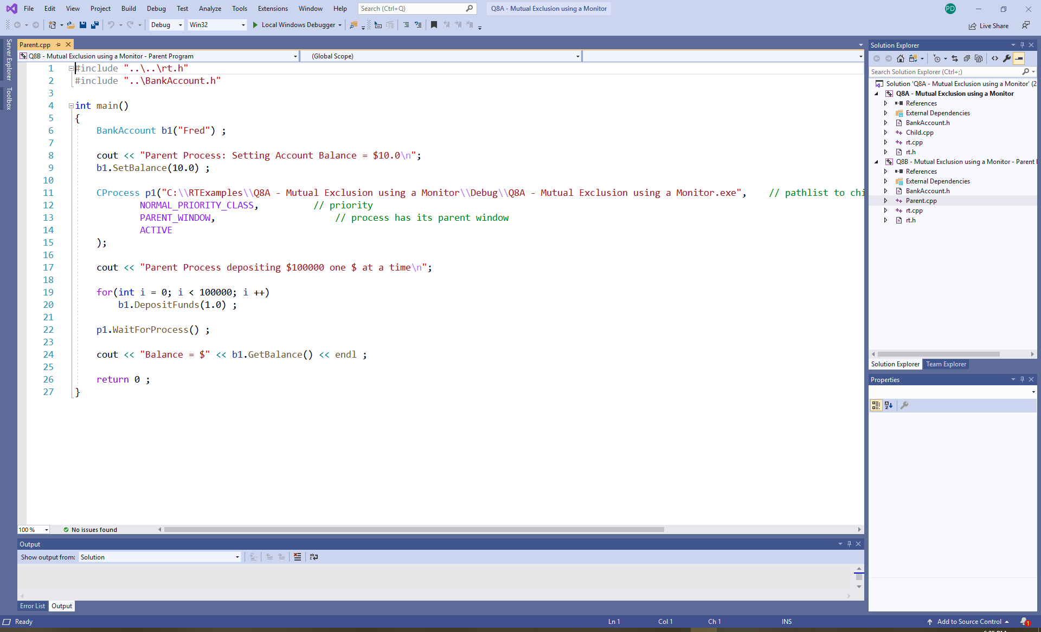
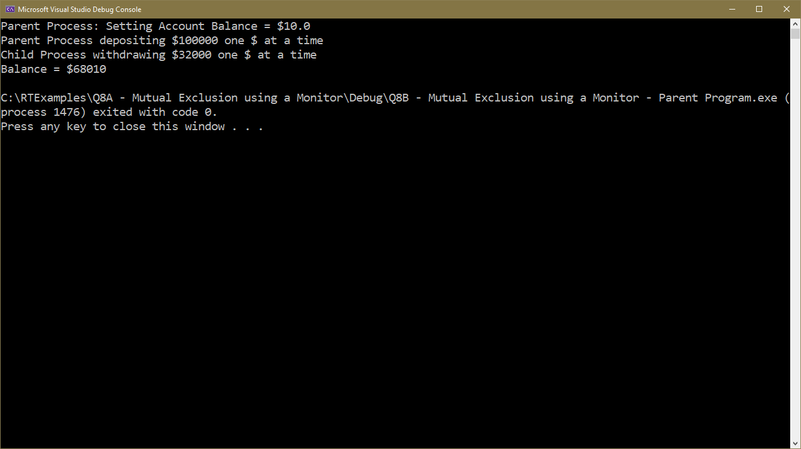
Q8A – Using a Monitor: This program uses two processes, one depositing, the other withdrawing money.
It also uses a named monitor (“Fred”) because it can be used across process boundaries.
Correct answer = $68010

Slide 26
Assignment 1 – Monitors used in your first Assignment
Monitor provides functions: Get_Elevator_Status() and Update_Status() which manipulate the Semaphores buried inside the monitor to provide synchronisation for producers and consumers of data between processes (see next lecture) .

Slide 27
Java Monitors
Java takes the concept of a Monitor one stage further in refinement by hiding the existence of the Mutex behind the concept of a synchronized method, which implies the existence of a hidden Mutex created by the compiler.
Only one synchronized function in the class object is ever permitted to run at any instant.
http://java.sun.com/docs/books/tutorial/essential/concurrency/syncmeth.html
Synchronized functions will be a feature of C++ multithreading in 2020 (http://www.modernescpp.com/index.php/multithreading-in-c-17-and-c-20)
public class BankAccount {
private double Balance ; //data to be protected
public synchronized BOOL Withdraw (double amount)
{
Balance = Balance – amount ;
}
public synchronized void Deposit (double amount)
{
Balance = Balance + amount ;
}
}

Slide 28
Supplement on
Semaphores and Mutexes
in C++ 11 and POSIX

Slide 29
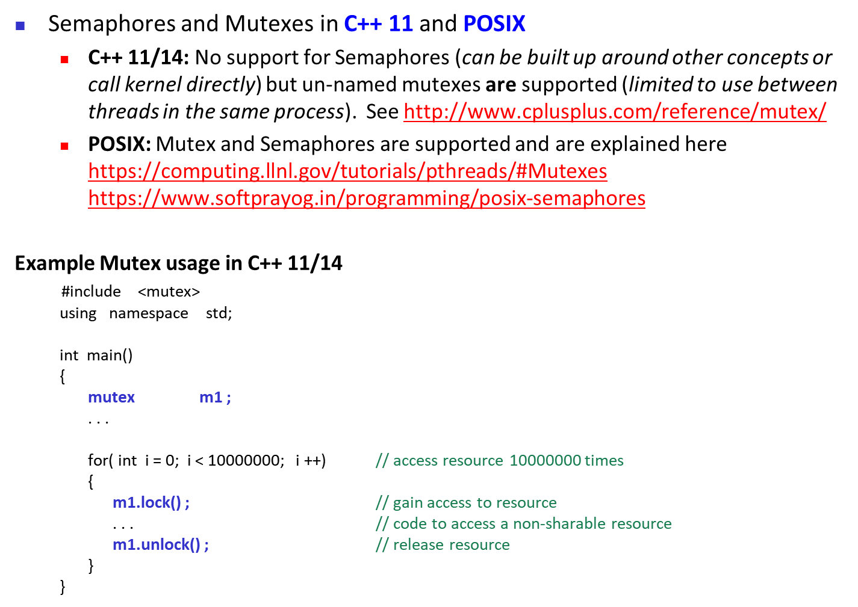
No named mutexes in C++ 11/14
lock() and unlock() equivalent to Wait() and Signal()

Slide 30
Extending C++ ’11 Mutex operation with a lock_guard
C++ ‘11 adds the concept of a local lock_guard variable that works in combination with a mutex (and other blocking types)
When the lock_guard is created, the Wait() function for the mutex is called by the constructor. When it goes out of scope, the Signal() function is called in the destructor.
#include <iostream>
#include <thread>
#include <mutex>
using namespace std;
int i = 0;
mutex m1;
void Increment()
{
for(int x = 0; x < 10000000; x++)
{
lock_guard<mutex> theLock(m1);
++i;
}
}
int main()
{
cout << "main: " << i << '\n';
thread t1(Increment);
thread t2(Increment);
t1.join();
t2.join();
cout << "main: " << i << '\n';
getchar();
}
Create a lock_guard variable “theLock” and wait for it to lock mutex m1
Once locked, i can be incremented
Each time around the loop, “theLock” goes out of scope and it’s destructor is called which calls Signal() to “unlock” the mutex.
Bottom line: no need to call lock/unlock, it’s also guarantees m1 will be unlocked at end of loop or function even if an exception occurs.

